Slide 1
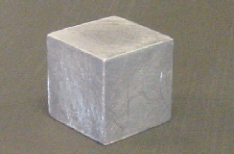
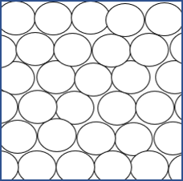
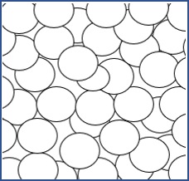
A particle model for the solid and liquid states (1/4)
1 Science has the idea that stuff is made from very small particles. Imagine you could see the particles in this block of lead. Which diagram best matches what you would see?
A Particles not moving
B Particles shaking on the spot
C Particle moving freely
D Particles not moving

Slide 2
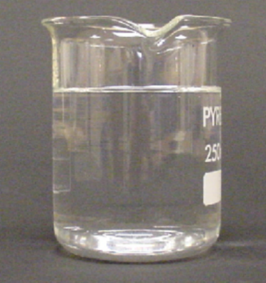
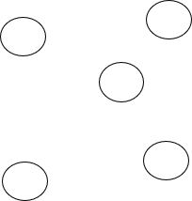
A particle model for the solid and liquid states (2/4)
2 Imagine you could see the particles in this beaker of water. Which diagram best matches what you would see?
A Particles not moving
B Particles not moving
C Particle moving freely
D Particles moving freely

Slide 3
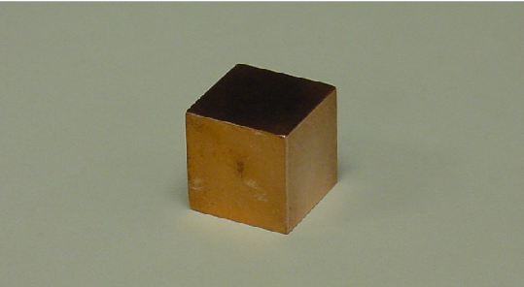
A particle model for the solid and liquid states (3/4)
3 Here is a block of copper at room temperature.
Which of A, B, C or D best describes it?
It is made of particles which are hard – like tiny bits of solid.
There are particles in rows surrounded by solid copper.
It is made of particles which are not like bits of solid copper.
It does not have any particles.

Slide 4
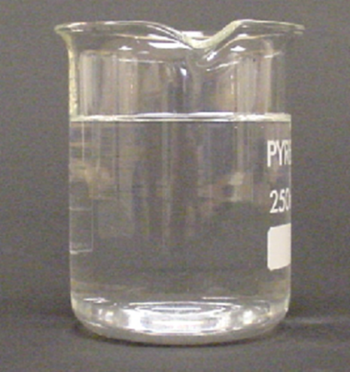
A particle model for the solid and liquid states (4/4)
4 Here is some water at room temperature.
Which of A, B, C or D best describes it?
It is made of particles which are not like bits of liquid.
It does not have any particles.
There are particles dotted about surrounded by liquid water.
It is made of particles which are runny, like drops of liquid.

